Slide 1

Mach distributed Operating system
Start

Slide 2
Group members
Hammad Ansari (2018450002)
Maulika Arekar(2018450003)
Diksha Bandagale (2018450004)
Riya Barve (2018450005)
Siddhesh Chaughule (2018450008)
Anuradha Date (2018450011)
Nilam Khatal (2018450026)
Pradnyot Morwekar (2018450033)
Pratik Pawar (2018450038)
Mantasha Shaikh [2018450047]
Prashika Walke [2018450059]
Chaitanya Yadav(2018450060)

Slide 3
COntent
Features and Goals
System Model & Kernel Model
System Architecture
IPC mechanism
Use of RPC
Objects and their Component.
Load Balancing
Process Management
Memory management/Device Management
Can this OS be used for implementing cloud -Cloud Example
Deployment model
Delivery model

Slide 4

WHOA!
Let’s get started
Go!

Slide 5

Mach is a microkernel-based operating system
Developed at Carnegie-Mellon University
By Richard rashid
With the support of DARPA

Slide 6
Features and goals
Hammad Ansari
Go!

Slide 7

Open-System Architecture
Compatibility with BSD UNIX
Network Transparency
Flexible Memory Management
Flexible IPC
High Performance
Simple Programmer Interface

Slide 8
Open-System architecture
Compatibility with BSD UNIX
Main Design Goal: Providing a base for building new operating systems and emulating the existing ones
Full compatibility with UNIX was an important goal of MACH. So, it could receive global acceptance.

Slide 9
Network transparency
Flexibility memory management
A higher level network wide naming system is used in Mach.
Mach provides an elaborate virtual-memory system that is implemented in terms of fixed-size pages.

Slide 10
FLExible ipc
High Performance
Mach uses a message-based IPC that is based on ports, which are kernel objects that hold messages.
MACH has performance penalty because of context switching between serving process and the microkernel. After all of these it still performs better.

Slide 11
Simple Programmer Interface
Mach provides simple interface for programmers which is Mach Interface Generator (MIG)
Mach Interface Generator allows the application programmers to use a service by simply making a procedure call, rather than making a system call or writing code for sending and receiving messages

Slide 12
System Model & Kernel Model
Maulika arekar
Go!

Slide 13
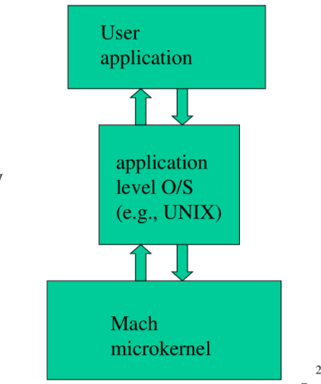
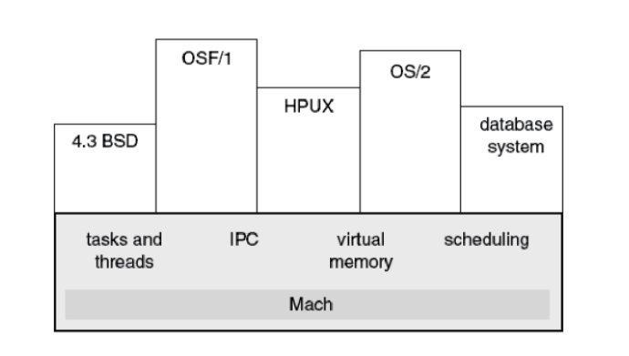
System MODEL of MACH

Slide 14
Five MAIN ABSTRACTION IN MACH KERNeL
Tasks
Processes
Threads
Ports
messages

Slide 15
What is Mach MICROKERNEL?
The Mach kernel is an example of modular layered approach to operating system design.
It provides flexible execution environment
Kernel provides only fundamental services
These services are basic but powerful enough to be used on wide range of architectures.

Slide 16
Mach MICROKERNEL FEATURES:
Task and thread management
Interprocess communication
Memory object management
System call redirection
Device support

Slide 17
System Architecture
Pradnyot morwekar
Go!

Slide 18
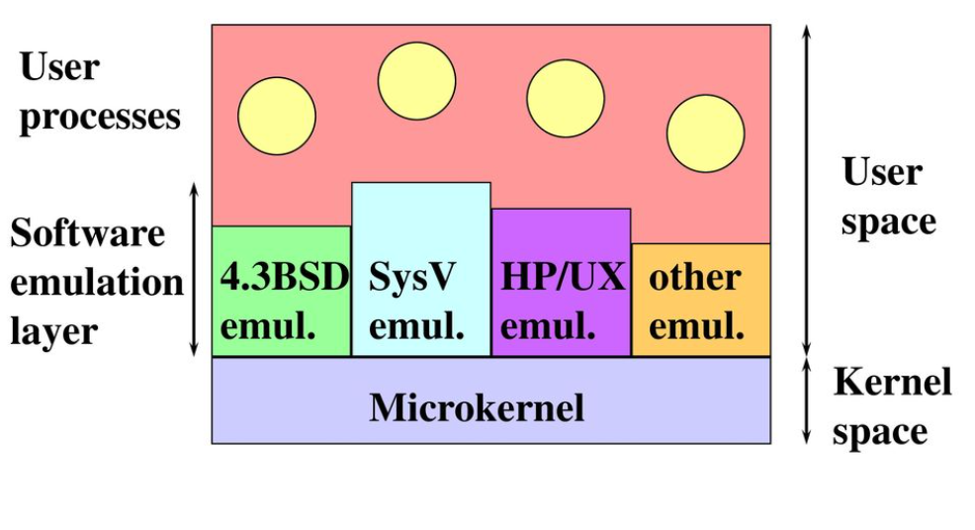
What is Mach MICROKERNEL
SYSTEM ARCHITECTURE

Slide 19
KEY ASPECTS OF Mach SYSTEM ARCHITECTURE
TailorabilitY
Portability
Network accessibility
Multiprocessor supporT
Security

Slide 20
IPC mechanism
Pratik pawar
Go!

Slide 21
IPC Mechanism
Inter-process communication (IPC) can be defined as set of techniques used for exchanging data among multiple threads in one or more processes.
The two components of Mach IPC are ports and messages.

Slide 22
techniques available for IPC
Shared Memory
Messages
Synchronization through IPC

Slide 23
Uses of RPC
Riya sachin barve
Go!

Slide 24
rpc?
A RPC is an interprocess communication technique that is used for client-server based applications.
Also known as a subroutine call or function call.

Slide 25
Uses
Exception-Handling
Remote Access
NetMsgServer
Programmer Interface

Slide 26
Objects and their Components
Chaitanya yadav
Go!

Slide 27
Objects
The data and the operations that manipulate the data are encapsulated into an abstract object.
MACH has a C-based object-oriented programming package.
(Which is integrated with the inter-process communication facility)
This provides the means to dynamically specify classes and objects.
Multiple inheritance, automatic object locking, garbage collection of objects, class/superclass hierarchy are all enabled due to this package.
Only the operations of the object are able to act on the entities defined in it.
The details of how these operations are implemented are hidden, as are the internal data structures.

Slide 28
Communication Components
Task is an execution environment that provides the basic unit of resource allocation.
Thread is the basic unit of execution and must run in the context of a task (which provides the address space).
Port is the basic object-reference mechanism in Mach and is imple-
mented as a kernel-protected communication channel.
(Task must have a port right to send a message to a port.)
port set is a group of ports sharing a common message queue.
( thread can receive messages for a port set and thus service multiple ports.)

Slide 29
Message is the basic method of communication between threads in Mach. It is a typed collection of data objects.
Memory object is a source of memory. Tasks can access it by mapping portions of an object.
memory object can be any object for which memory-mapped access makes some sense.

Slide 30
Load Balancing
Nilam khattal
Go!

Slide 31
Load Balancing
Distribution of load to the processing elements
It’ a strategy make every processor equally busy & finish work at same time
Load balancing operation
Location Rule Distribution Rule Selection Rule
Improves performance of each node
Reduces job idle time
Quality depends on no of steps & extent of load

Slide 32
Types of Load Balancing
Static Load Balancing
Processes assigned at compile time.
No change or reassignment
Probabilistic algorithm
Dynamic Load algorithm
Job/reassigned done at runtime
Communication over heads

Slide 33
Process management
Diksha Bandagale
and
Siddhesh chaughule
Go!

Slide 34
Basic Abstraction
The two basic abstractions used for process management in Mach are task(Process) and thread.
Process and Thread States
At any instance of time, a thread may be in one of the following states:
Running.
Suspended.

Slide 35
Operations on Processes and threads
Each process owns a process port and each thread owns a thread port.
Process management primitives provided in Mach include those for creating a process, killing a process, suspending or resuming a process
In Mach, threads are managed by the kernel..

Slide 36
The C-threads Package
The C-threads package allows the programmers to use the kernel thread primitives in a simple and convenient manner.
The routines for direct thread manipulation are given below:
Cthreadfork
Cthreadexit
Cthreadjoin
Cthread_detach
cthreadyield

Slide 37
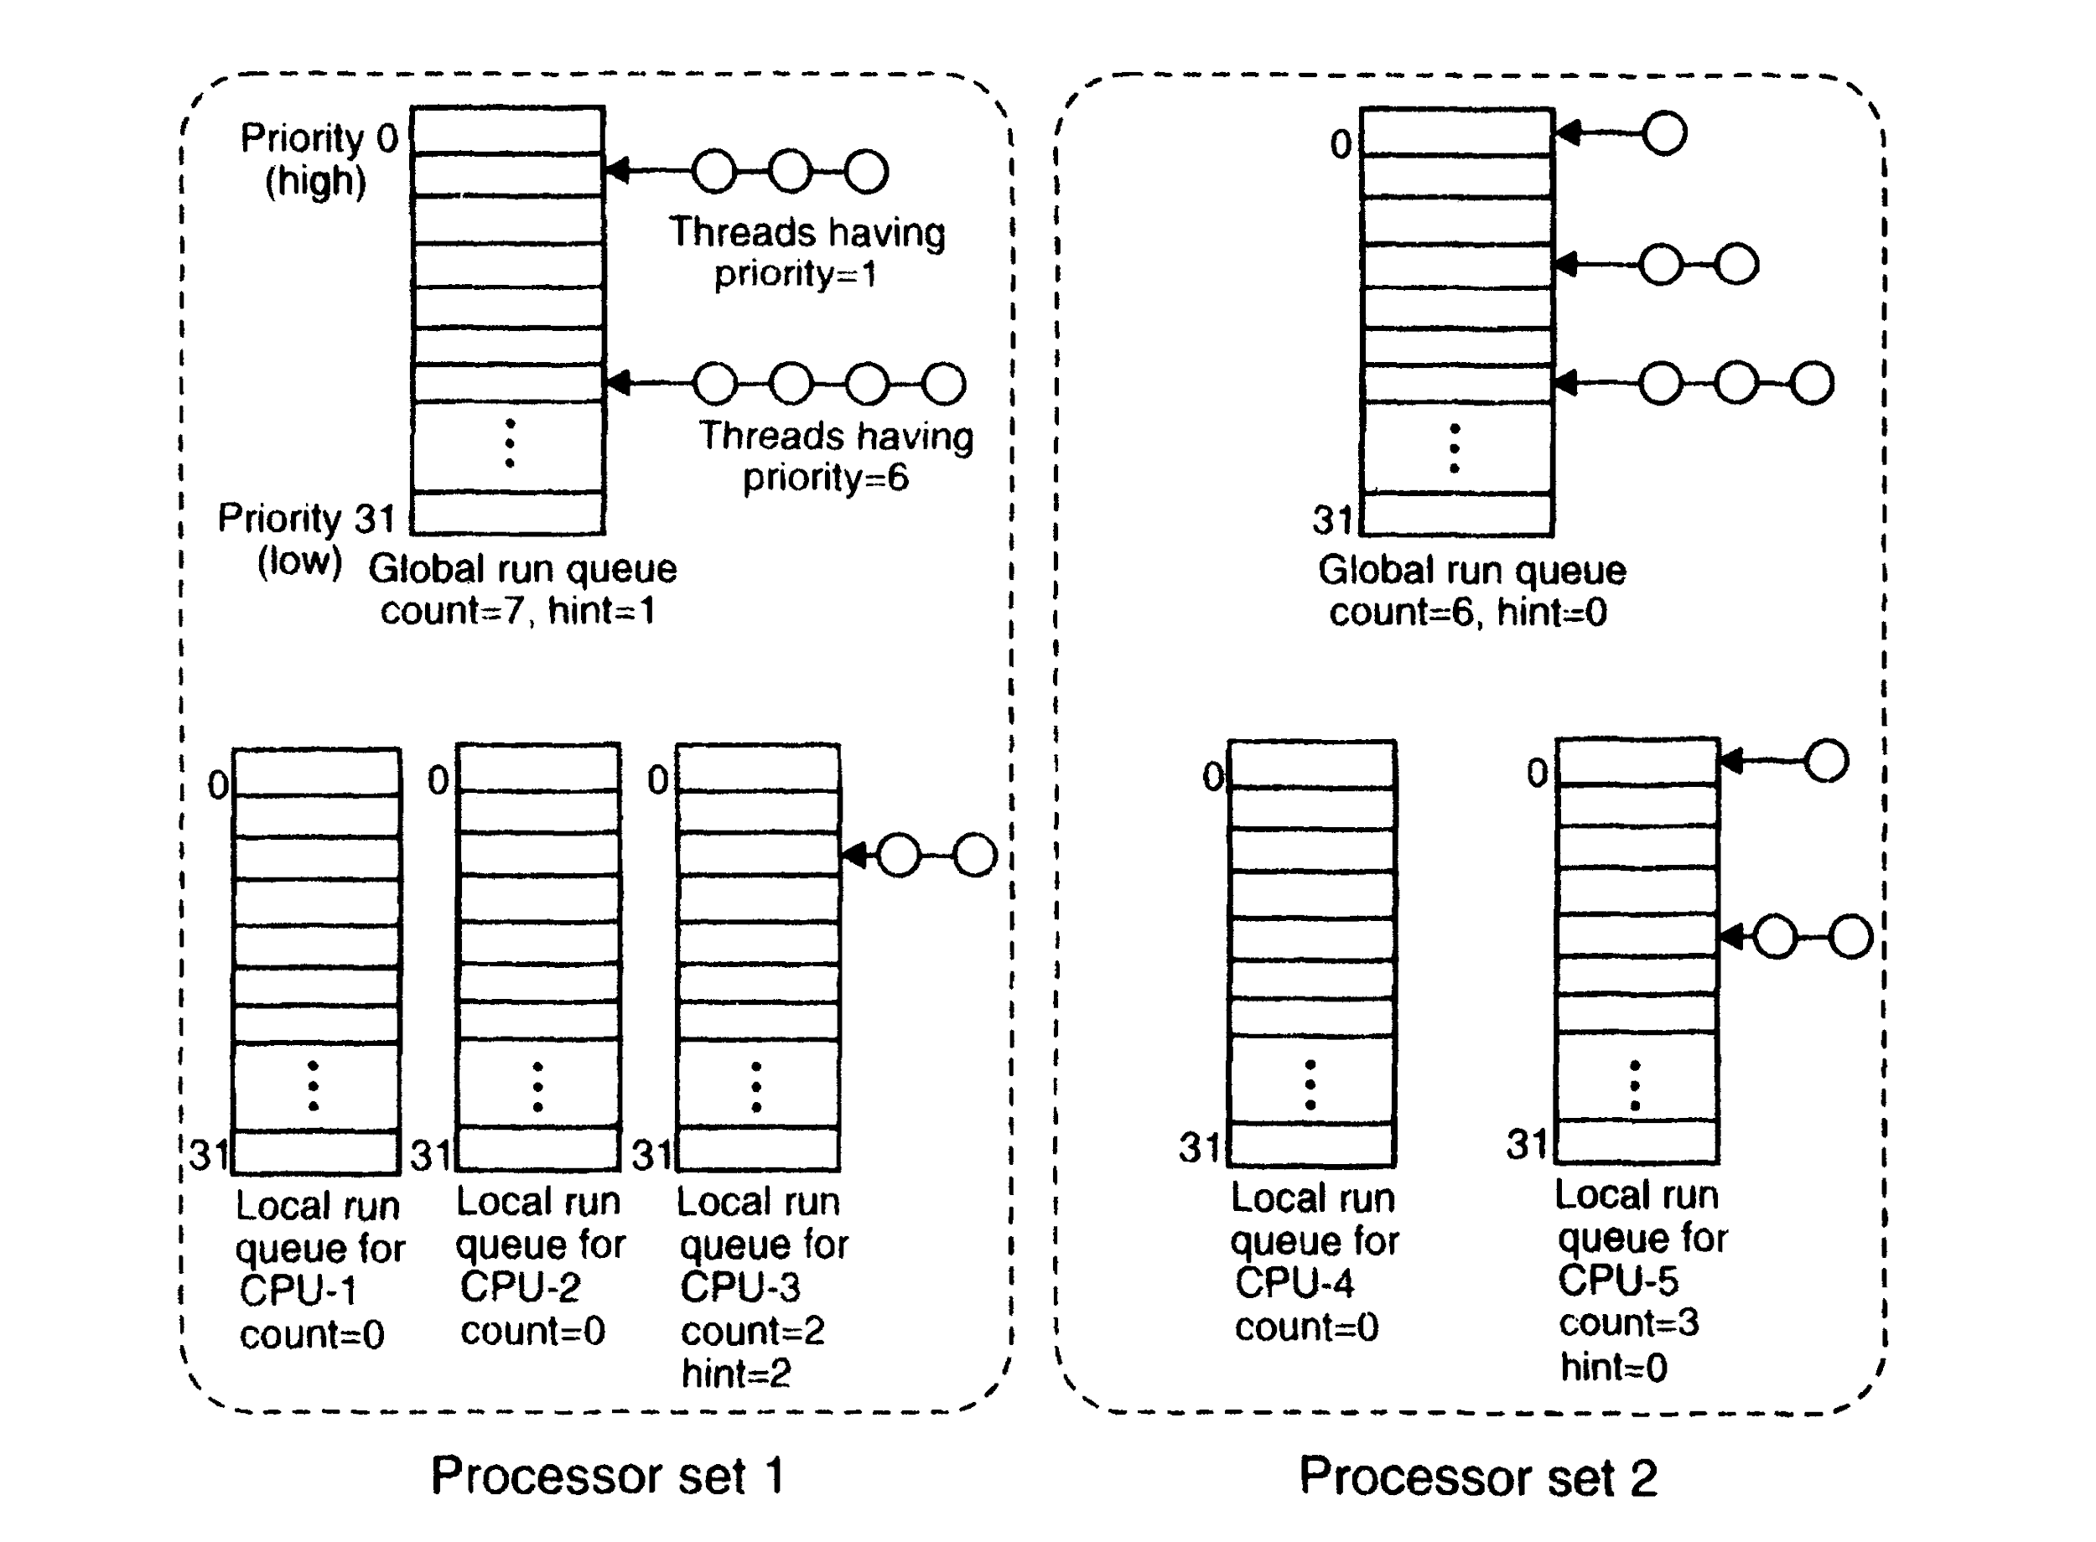
Threads Scheduling

Slide 38
Scheduling algorithm
When a thread blocks, exits or uses up its quantum, CPU looks on local run queue to see if there are any active threads.
If it is nonzero, search for highest priority thread.
If empty, same algorithm applied to global run queue.
If no thread to run, a special idle thread is run until some become ready

Slide 39
ScheDUliNg AlgoriThm COTD.
If a runnable thread found, scheduled and run for one quantum.
After one quantum, check local and global queue for any runnable thread.
If found, thread switch occur
If not found, thread run for another one quantum

Slide 40
Memory management
Anuradha date
Go!

Slide 41
Memory Management
Memory objects are used to manage secondary storage
They represent the files ,pipes etc
User-level Memory Managers
Back up the Memory object
Responsible for consistency
System Calls
Allocate , deallocate and return information
Shared Memory
Supported only when execution is on processors that share memory
Reduces complexity

Slide 42
Memory Management
Is split in 3 parts
Pmap module
Machine independent kernel code
The memory manager

Slide 43
Cloud Example
Mantasha shaikh
Go!

Slide 44
Cloud example
Yes, we can use Mach as a cloud operating system.
In 1989, OSF a consortium of computer vendors, selected Mach.
OSF has important companies like IBM, HP. & DEC.
NeXT workstation also used Mach.
It is compatible with BSD Unix.
Although, cloud platforms uses their own flavor of linux.

Slide 45
Deployment model
Go!

Slide 46
Deployment model
Public Cloud
Services are rendered by third-party providers over a network open for public use.
Provide an access control mechanism for their users.
No responsibilities over the management of the cloud – you only use it to store your data, and pay as you go.
Private Cloud
A private cloud refers to a cloud deployment model operated exclusively for a single organization.
Mach can be deployed using private cloud deployment model.

Slide 47
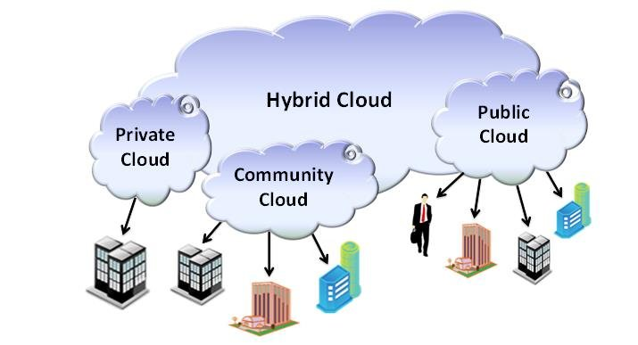
Deployment model
Hybrid Cloud
Hybrid Cloud is a type of Cloud Computing which is integrated into more than two cloud servers.
For example, in case of high-volume, less sensible data that doesn’t require strong security layers.

Slide 48
delivery model
Prashika walke
Go!

Slide 49
Delivery model
Infrastructure-as-a-service(IaaS)
The IaaS delivery model represents a self-contained IT environment that can be accessed and managed via cloud service-based interfaces.
This environment can include hardware, network, connectivity, operating systems, and other “raw” IT resources.
The general purpose of an IaaS environment is to provide cloud consumers with a high level of control and responsibility over its configuration and utilization.
Mach can be delivered using IaaS delivery model.
Platform-as-a-service(PaaS)
The PaaS delivery model represents a predefined “ready-to-use” environment typically comprised of already deployed and configured IT resources.
Specifically, Paas relies on (and it's primarily defined by) the usage of a ready-made environment.
That establishes a set of pre-packaged products and tools used to support the entire delivery lifecycle of custom applications.

Slide 50
Delivery model
Software-as-a-service(SaaS)
The SaaS delivery model is typically used to make a reusable cloud service widely available to range of cloud consumers.
An entire marketplace exits around SaaS products that can be leased and used for different purposes and via different terms.
A cloud consumer is generally granted very limited administrative control over a SaaS implementation.
It is most often provisional by the cloud provider, but it can be legally owned by whichever entity assumes the cloud service owner role.

Slide 51
References
PK Sinha - Distributed Operating System
OS Book - https://www.os-book.com/OS9/appendices-dir/b.pdf

Slide 52
THANKS!
Any Questions?

